Slide 1


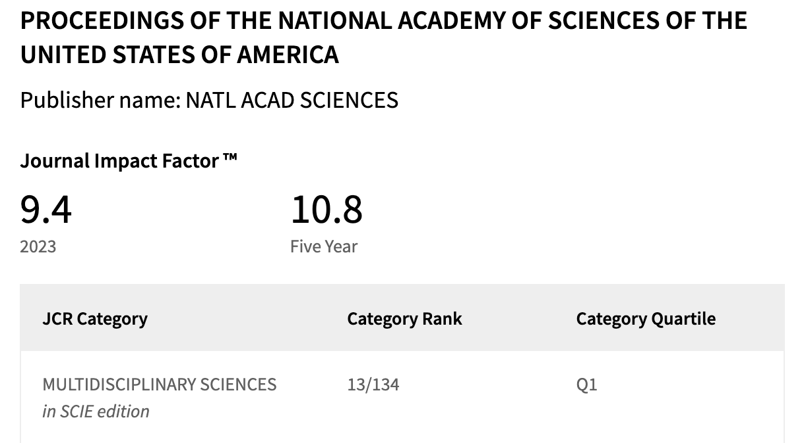
Small molecule photocatalysis enables drug target identiﬁcation via energy transfer
Published in 2022.06
Guo Jiayi

Slide 2



Authors
David MacMillan
Princeton University
Aaron Trowbridge
Lecturer at university of Manchester
Nobel Prize in Chemistry (2021)
Asymmetric organocatalysis
Chemical biology
Molecular Oxygen Editing
Sustainable Photocatalysis

Slide 3
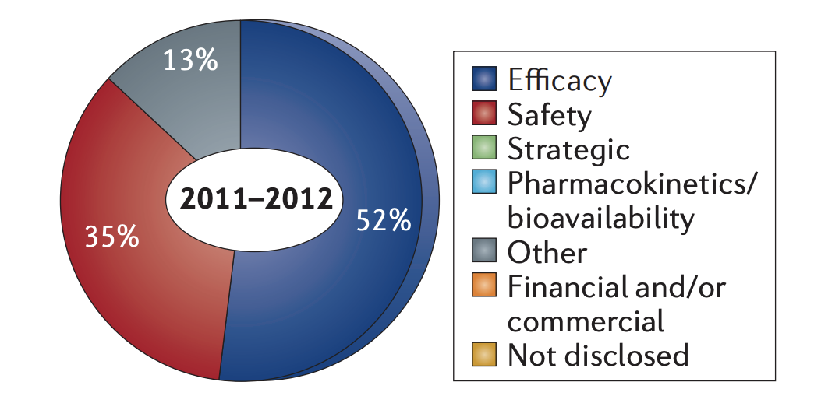
Background
During last decade, over 50% of drugs in phase2 and phase3 clinical trials have failed……
The lack of Efficiency
Incomplete target validation
The Identification of biological target and understanding of interaction at molecular level
(Target ID)
Fig1. Reasons for failures in Phase II and Phase III trials in 2011 and 2012
Arrowsmith, J., Miller, P. Phase II and Phase III attrition rates 2011–2012. Nat Rev Drug Discov 12, 569 (2013).

Slide 4
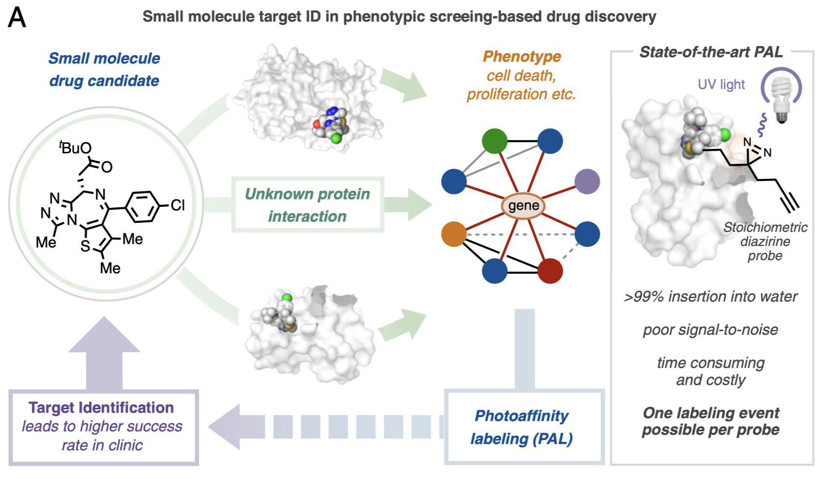
Background
Bioinformatics, Mass spectrometry, Chemical genetics improved the understanding of cellular pathways…
Bioinformatics
Provide more precise approach in complex process of drug discovery
Mass Spectrometry
Chemical Genetics
Fig1. Application of Different approach in drug discovery
Fig2. Small molecule target ID in phenotypic screening-based drug discovery and its deficient

Slide 5
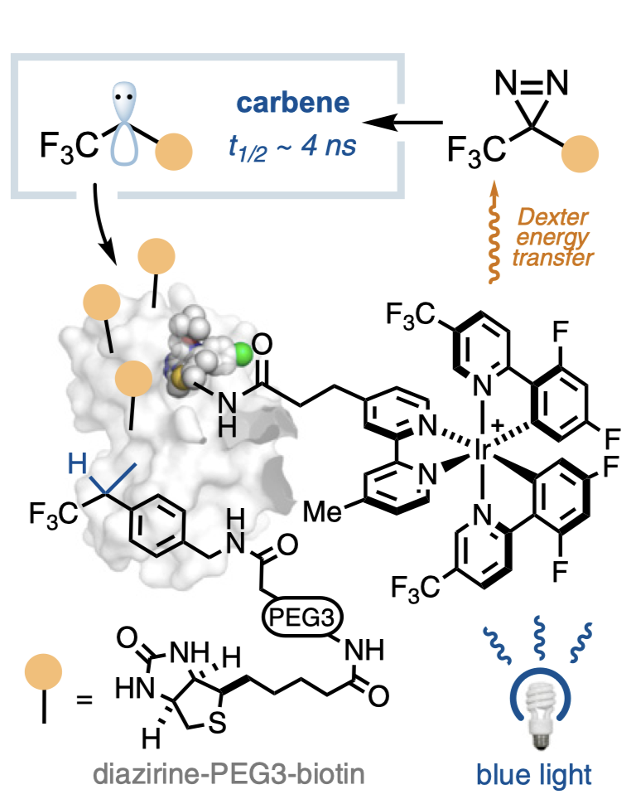
Improvements made by Photocatalytic
Carbene
Rapidly form covalent bond with target proteins
Photocatalyst group
Activated by blue light
Further activate Diazirine to generate Carbene
Diazirine-biotin group
Can be activated by Dexter energy transfer
Labelling the target
Increased specificity
Signal Amplification
Efficiency
Fig1. Visible light-mediated photocatalytic target ID
J. B. Geri et al., Microenvironment mapping via Dexter energy transfer on immune cells. Science 367, 1091–1097 (2020).

Slide 6
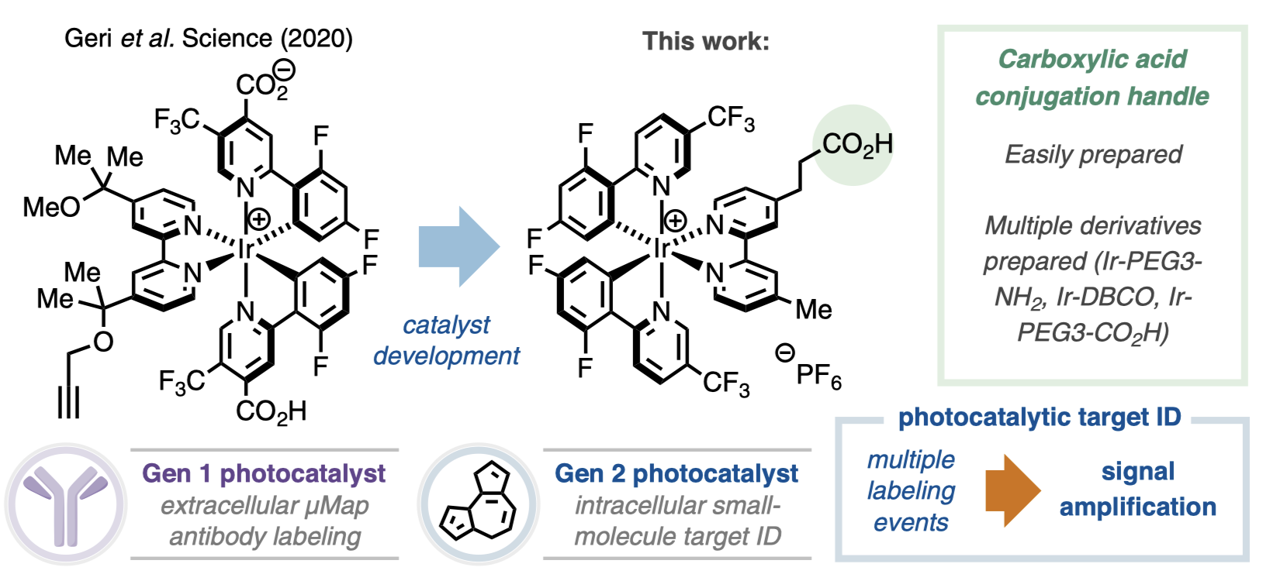
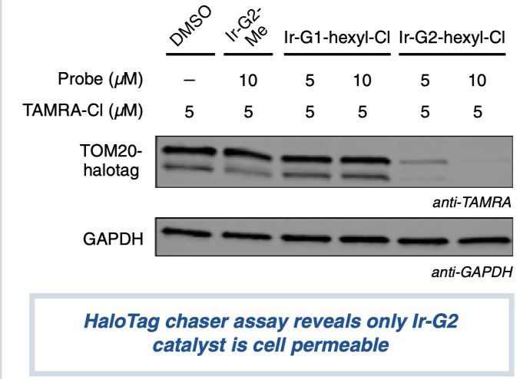
Designed Photocatalyst for Enhanced Cell Permeability and Intracellular Targeting
TAMRA-CI: Fluorescent probes labeled with TOM20-HaloTag
TOM20: A protein located on the membrane of Mitochondria
Fig2. Cell permeability of Ir-photocatalysts determined by HaloTag chaser assay
Fig1. intracellular photocatalyst suitable for small molecule target ID
Changes of structure truly improve the permeability of Catalyst
J. B. Geri et al., Microenvironment mapping via Dexter energy transfer on immune cells. Science 367, 1091–1097 (2020).

Slide 7
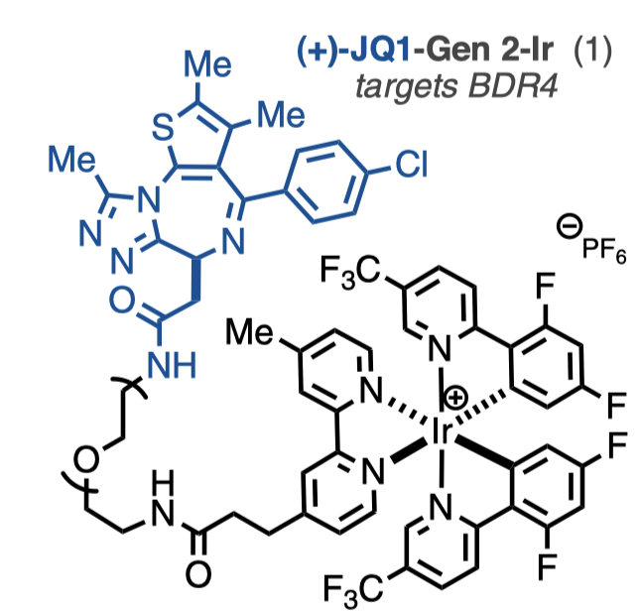
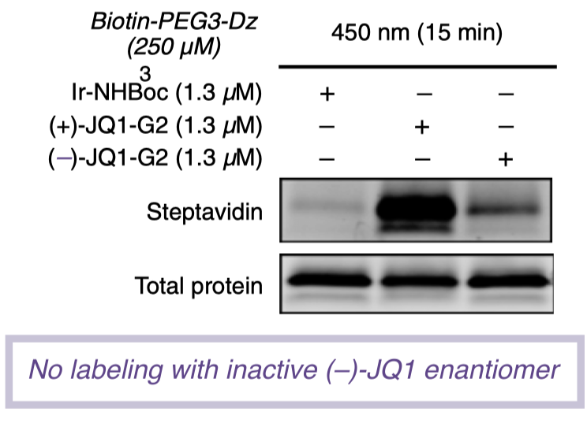
The photocatalyst truly increase the specificity of Target ID
To further test whether this method can access any Ir-Drug conjugate
Here, they employ an inhibitor of the BRD4, and a spectator protein CA
Labeling of recombinant CA & BRD4
Can bind with biotin
Fig2. Western blot assay result of labelling recombinant CA & BRD4
Fig1. The structure of (+)-JQ1-Gen 2-Ir conjugate

Slide 8
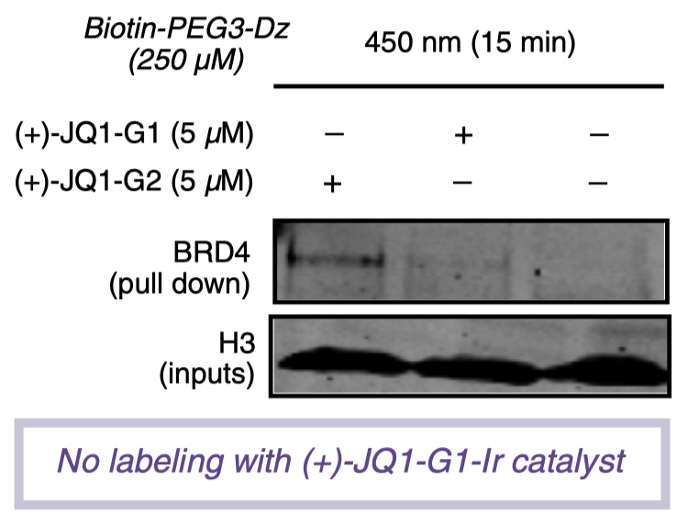
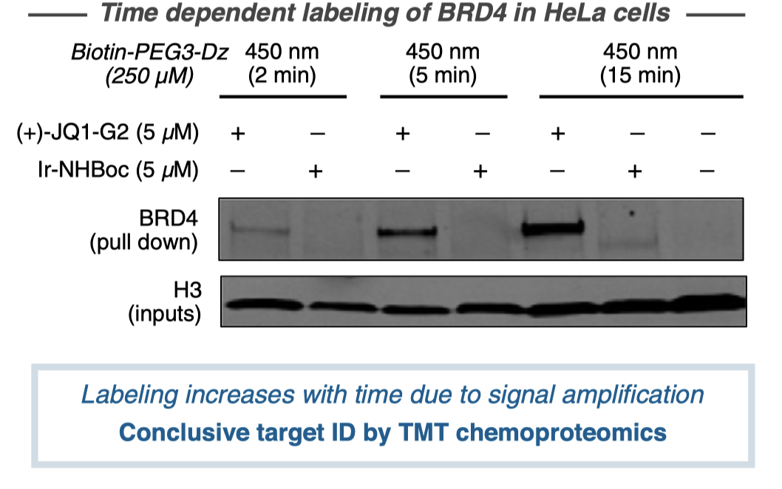
This Photocatalyst also works in the live cells in a time-dependent manner
The intensity of labeling was found to be linearly related to irradiation time
Fig1. Comparing permeability of G1- and G2-based (+)-JQ1 probes following irradiation in HeLa cells
The G2-based (+)-JQ1 probe successfully identified the BRD4 protein
Fig2. BRD4 labeling increases over time (2-min, 5-min, and 15-min irradiation)

Slide 9
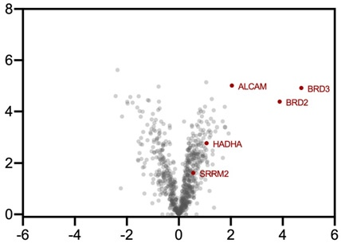
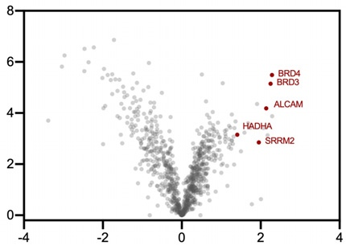
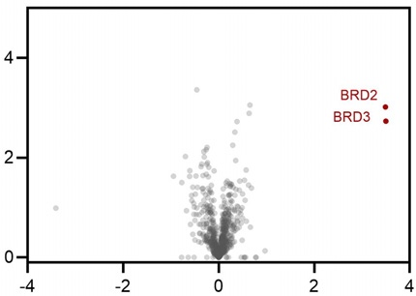
The Targeting of (+)-JQ1 is specific
(+)-JQ1-G2-Ir (1) vs. Ir-NHBoc (free-Ir)
(+)-JQ1-G2-Ir (1) vs. Ir-NHBoc + (+)-JQ1
Comparing with (-)-JQ1-, only BRD2 and BRD3 was enriched.
This stereogenic center improves the specificity of Targeting
(+)-JQ1-G2-Ir (1) vs. (-)-JQ1-G2-Ir (inactive)
Fig1. Quantitative chemoproteomic analysis shows enrichment of several BRD proteins in HeLa cells labeled with (+)-JQ1-Gen 2
BRD proteins are highly enriched due to the specifically binding of (+)-JQ1-Gen 2, and was not affected by using Ir-NHBoc
The binding and labelling by (+)-JQ1 is indeed specific
Fig2. Comparative analysis of the interactomes of (+)-JQ1-G2 enantiomers

Slide 10
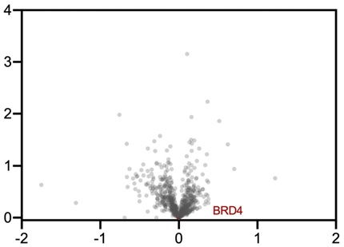
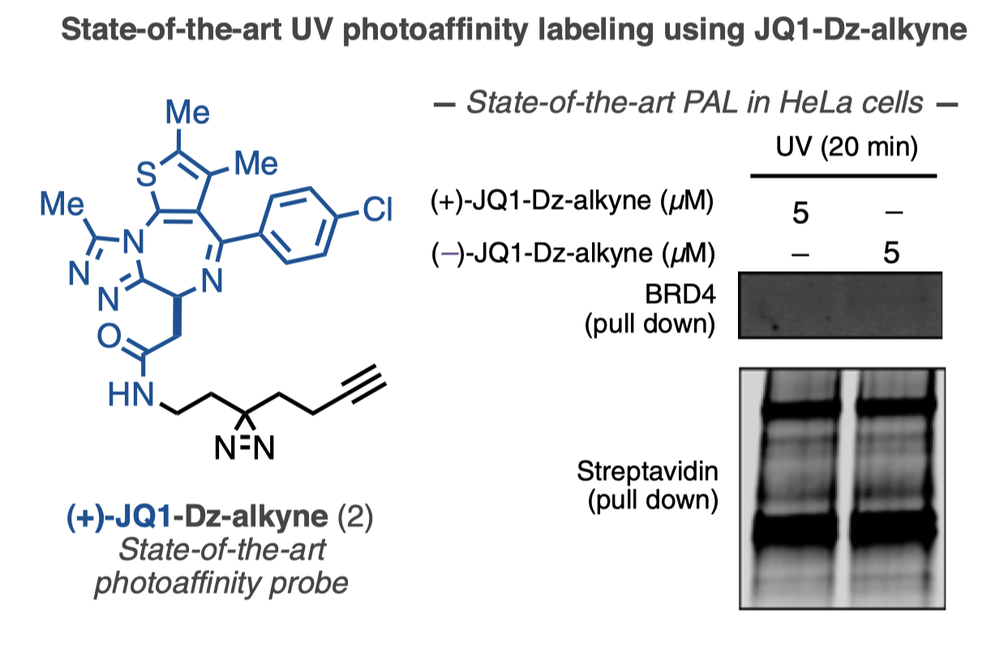
Comparing with state-of-art PAL
(+)-JQ1-Dz-alkyne (1) vs. (-)-JQ1-Dz-alkene
Fig2. TMT-based quantitative chemoproteomic analysis
The UV-PAL didn’t lead to selective enrichment of BRD4
Fig1. State-of-the-art PAL employing active (+)-JQ1- and inactive (–)-JQ1-Dz-alkyne probes

Slide 11
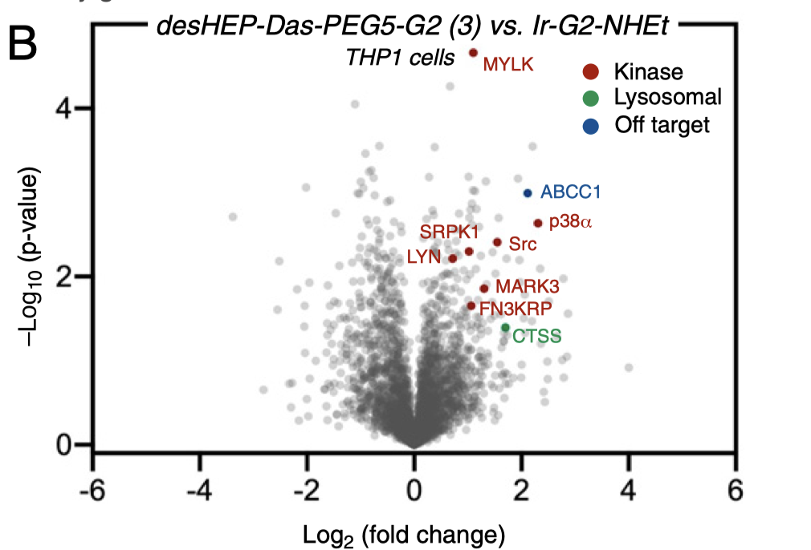
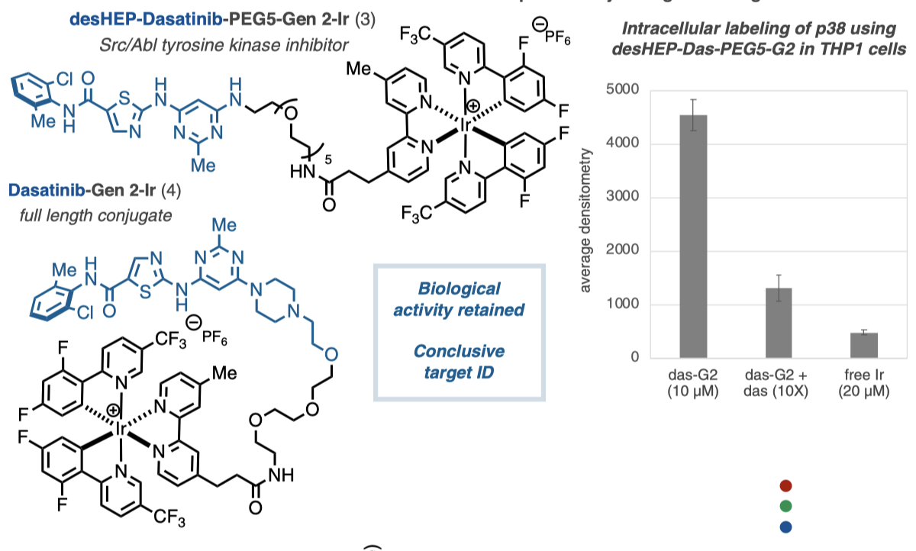
Using the Photocatalyst to identify the target of Dasatinib(Das)
Previous studies have demonstrated difﬁculties in maintaining potency and cell permeability using dasatinib-derived probes
Successfully enriched p38
Fig2. Label-free proteomic analysis in THP1 cells
The desHEP-probe successfully identified the target of Das
To improve the permeability of probes
Fig1. The designed Probe and ntracellular labeling of p38 using
desHEP-Das-PEG5-G2 in THP1 cells
Enrichment of several kinases (red), as well as lysosomal proteins (green)
Das-G2 compete with free das

Slide 12
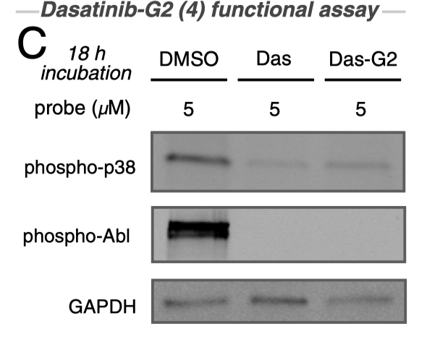
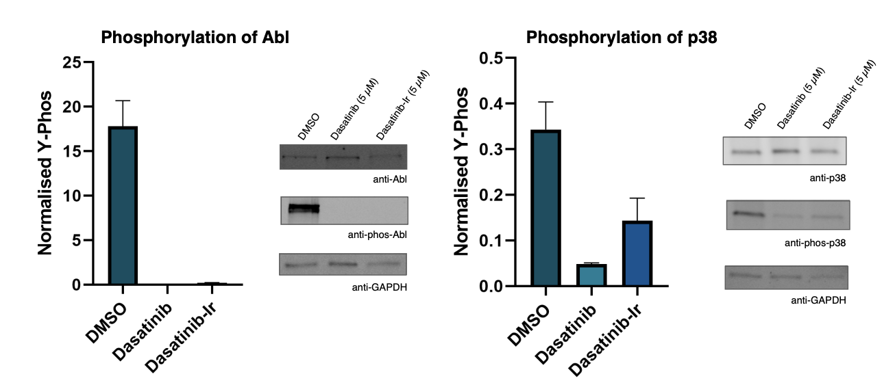
Dasatinib-G2 probe can Identify the target protein as well
The kinase binding to the probe or natural Das
Fig1. Kinase activity assays
Fig2. Analysis of cellular activity in K562 cells with dasatinib vs Dasatinib-PEG3-Ir and DMSO controls.

Slide 13
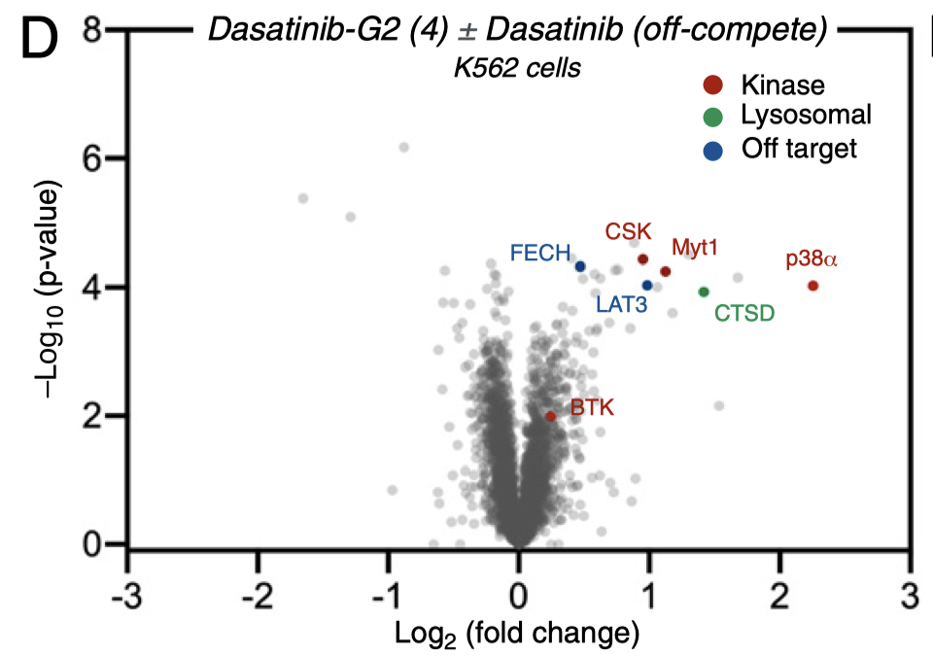
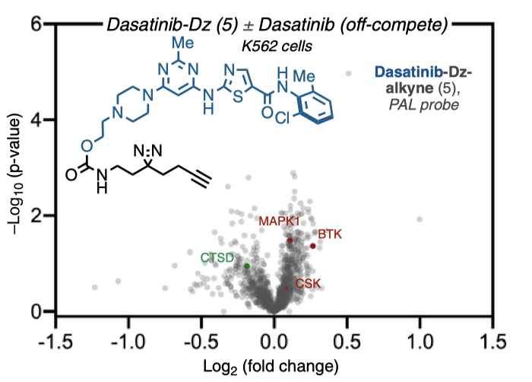
Comparing with state-of-art PAL
Fig1. TMT-based quantitative chemoproteomic analysis in K562 cells
Fig2. TMT-based quantitative chemoproteomic analysis in K562 cells
The Dasatinib-G2 identified extensive enrichment of kinases p38, Myt1, and CSK, confirming the binding specificity
The Dasatinib-Dz only lead to trace enrichment of certain kinases

Slide 14
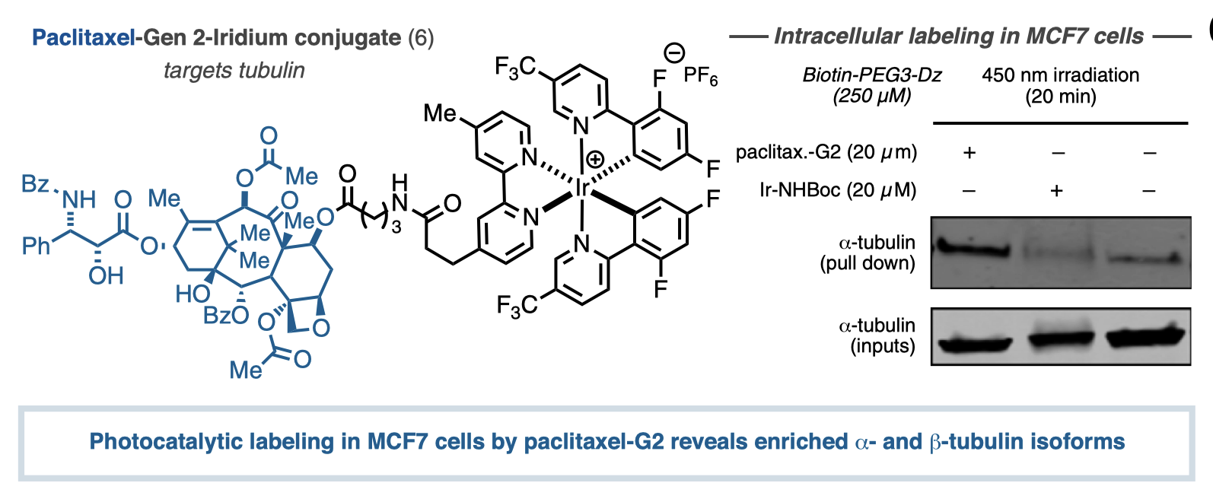
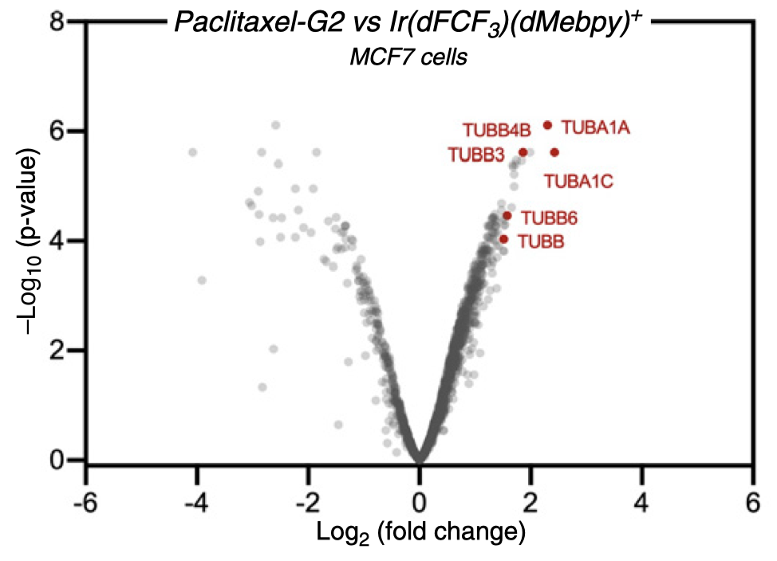
Identification of Paclitaxel targets
Paclitaxel have been proposed to be binding to microtubules, leading to stabilization and mitotic arrest however, the full extent of its mechanism remains unclear
The isoforms of tubulin also enriched by photocatalyst
Fig2. TMT-based quantitative chemo-proteomic analysis in MCF7 cells
Successful labeling of tubulin in breast cancer cells with Gen2-Iridium
Fig1. Western blot analysis with anti-α-tubulin

Slide 15
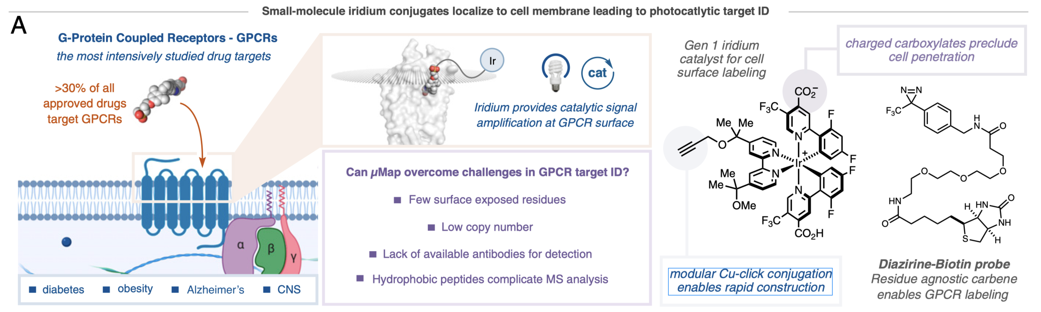
Photocatalystic Target ID is an ideal platform for Targeting GPCRs
After discussing the efficiency of photocatalytic target ID for Intracellular protein. We turned our attention to cell surface….
Fig1. An overview of the use of photocatalytic iridium conjugates for targeting G protein-coupled receptors (GPCRs)

Slide 16
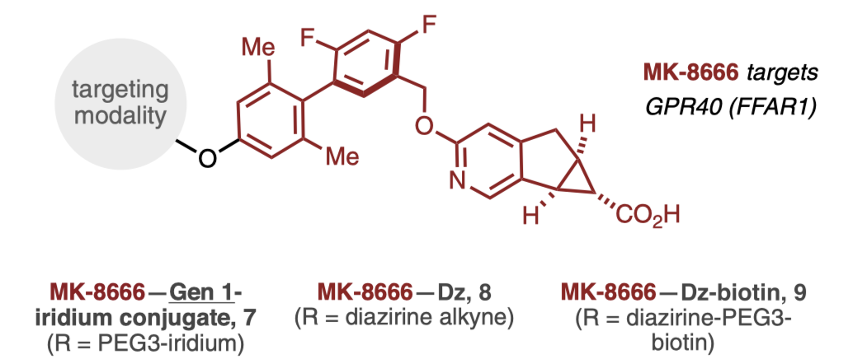
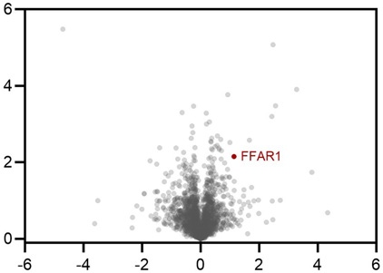
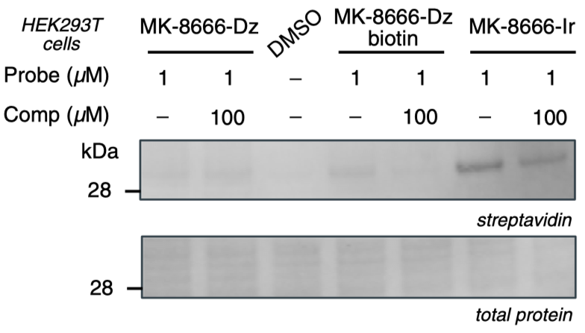
Photocatalytic target identification (ID) versus classical UV-based PAL
MK-8666-Ir (7) ± MK-8666 (off-compete)
Fig2. TMT-based quantitative chemo-proteomic analysis in GPR40-expressing HEK293T cells
Photocatalyst G1 labelled more GPR40 protein than Dz-biotin
Fig1. Comparative analysis of labeling of GPR40
FFAR1 was significantly changed using MK-8666-Ir

Slide 17
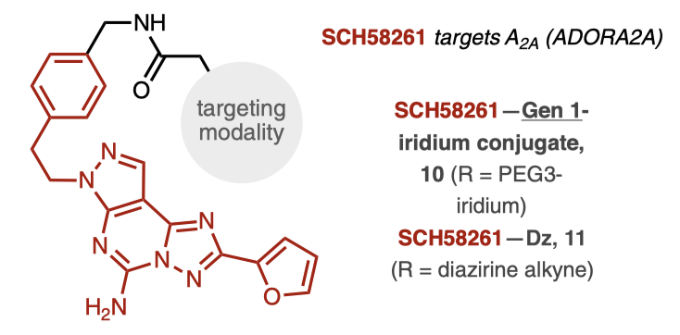
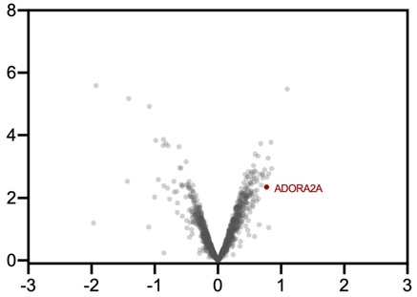
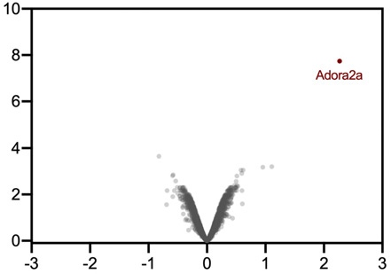
Another example of membrane protein
Photocatalyst G1 more significantly identified ADORA2A in different cell types
SCH58261-Dz (11) ± SCH58261 (off-compete)
SCH58261-G1 (10) ± SCH58261 (off-compete)
Fig1. TMT-based quantitative chemo-proteomic analysis in A2a-expressing HEK293T cells
Fig2. TMT-based quantitative chemo-proteomic analysis in PC-12 cells

Slide 18
Pros and Cons
Pros
Cons
This research describe a general platform for Target ID of the intracellular proteins and prove its reliability
The author did not mention the limitation of this technology
The photocatalytic target ID has allowed for the identiﬁcation of multiple protein targets and off-targets across multiple drug classes and cellular compartments
The specificity can be further improved
There might be some side effect of this photocatalyst because of the metal ions
The whole process of validating the reliability can also served as a reference for other similar researches
This technology uses blue light, which ensure the sample integrity

Slide 19
Questions
What are the difficulties for small molecule drug’s target identification?
Transient interaction
Specificity
What further research we can conduct with this new technology?

